Slide 1
Signals and Systems
Lecturer:
Dr. Bin Xia
Dept. of Electronic Engineering
Shanghai Jiao Tong University
Tutorial

Slide 2
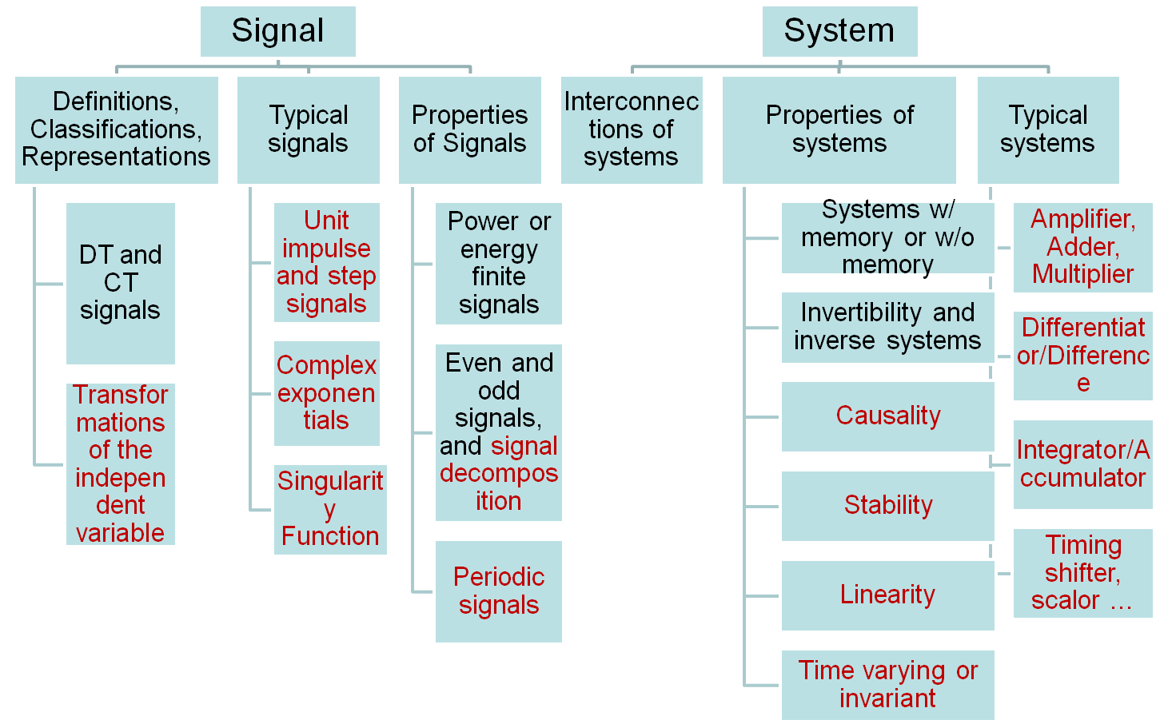
Ch. 1 Introduction

Slide 3
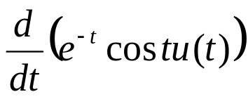
To plot the waveforms of the following signals
  x(t)=u(t²-1)

Slide 4
Consider a continuous-time system with input x(t) and output y(t) related by
y(t)=e^{-2t}x(t-1)
to determine whether it is
Linear
Time invariant
cause
Hints: using the definitions of these properties to see if these properties hold or not.
Linear
Time varying
Causal

Slide 5
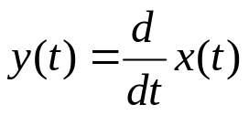

For ,repeat 1)~3)
Linear
Time invariant
Causal, non-causal??
For , repeat 1)~3)
Non-linear
Time varying
Causal and memoryless
For y(t)=x(t)cos(t+1), repeat 1)~3)
Linear
Time varying
Causal and memoryless

Slide 6
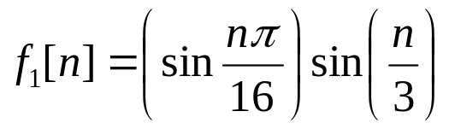
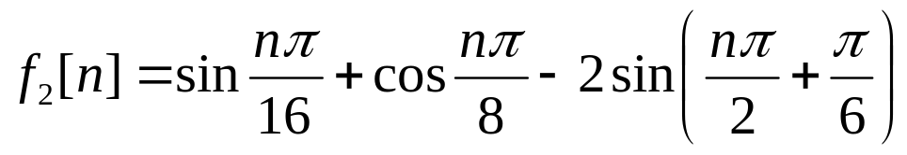
To determine if the following signals are periodic or not, if yes, pls find its fundamental period

Slide 7
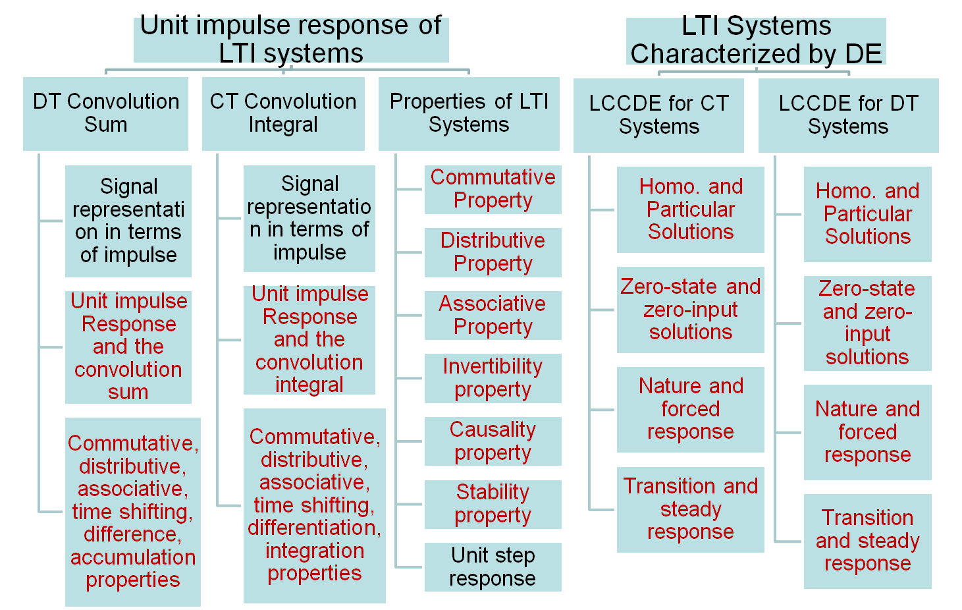
Ch. 2

Slide 8
Calculate the convolution integration of x₁(t)=1+u(t-1) and x₂(t)=e^{-(t+1)}u(t+1)
To exploit the differential property of convolution integral? (to differentiate x1(t) and then convolution integral with the integration of x2(t))
Because the output of the integrator is NOT the same as the input x₁(t), unless the input to the differentiator satisfies x₁(-∞)=0
x₁(t)
Differentiator
Integrator
x₁(t)
x₂(t)
x₁(t)*x₂(t)

Slide 9
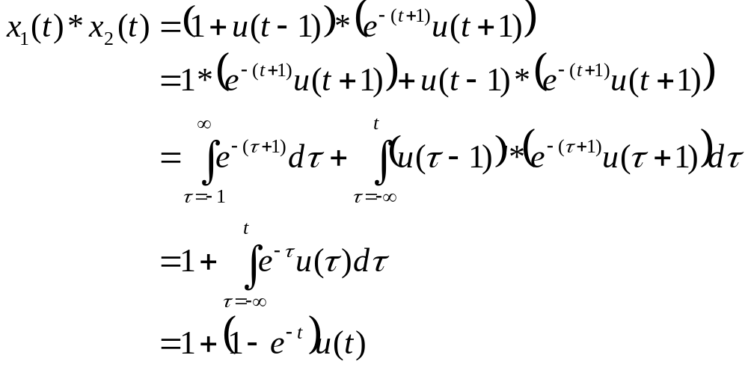

Slide 10
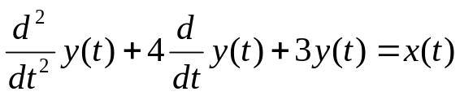




For a system represented by a linear constant-coefficient differential equation
and auxiliary conditions
,
when x(t)=u(t)
to calculate the zero-state response and the zero-input response of the system
to calculate the homogenous response and the particular response of the system
Recalculate 1) and 2), when the auxiliary conditions are
How to determine the discontinuous output from 0- to 0+
If the auxiliary condition is for x(t)=δ(t), repeat 1) and 2)

Slide 11
To calculate the zero-state response and the zero-input response of the system by means of unilateral Laplace transform
To determine its system function, and draw its pole-zero plot.
To calculate the zero-state response by means of CT Fourier transform, and determine its frequency response

Slide 12

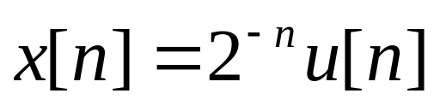
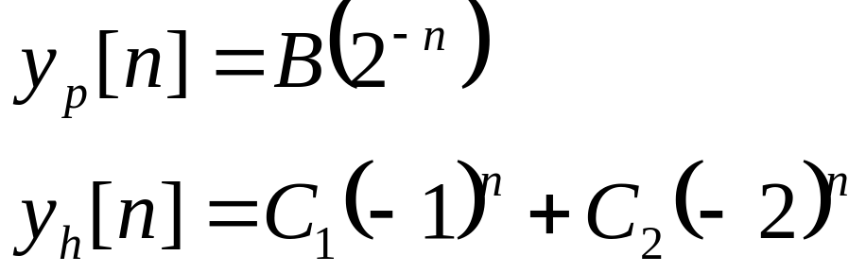
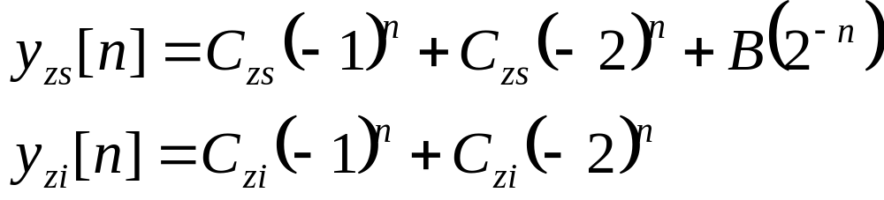
Consider a system characterized by
with initial conditions that y[-1]=0, y[-2]=1
Determine the complete response of the system to the input
It can also be calculated by means of convolution sum approach

Slide 13
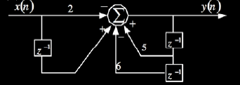
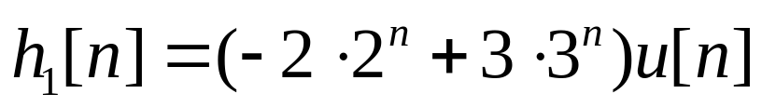
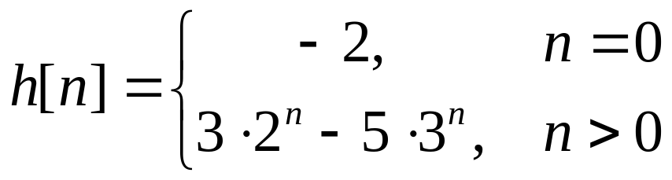
For a given block diagram of a system, please find its linear difference equation and its impulse response
y[n]-5y[n-1]+6y[n-2]=-2x[n]+x[n-1]
For h₁[n] is the impulse response of y[n]-5y[n-1]+6y[n-2]=x[n]
we have
Then the impulse response of the system in the Figure is

Slide 14
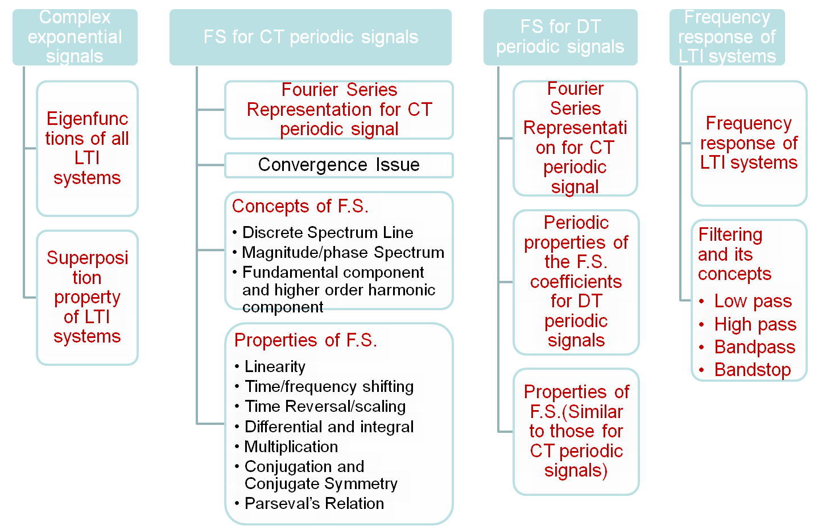
Ch. 3

Slide 15
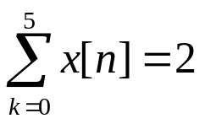
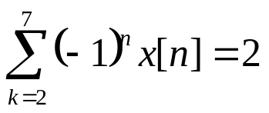
Suppose we are given the following facts about a sequence x[n]:
  x[n] is periodic with period N=6
  x[n] has the minimal power per period among the set of signals satisfying the preceding three conditions
From 2, we obtain a₀=1/3
From 3, we obtain a₃=1/3
From Parseval’s relation, we obtain a1=a2=a4=a5=0
Then x[n]=….

Slide 16
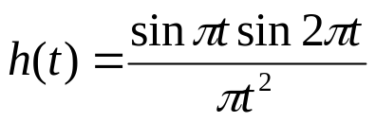
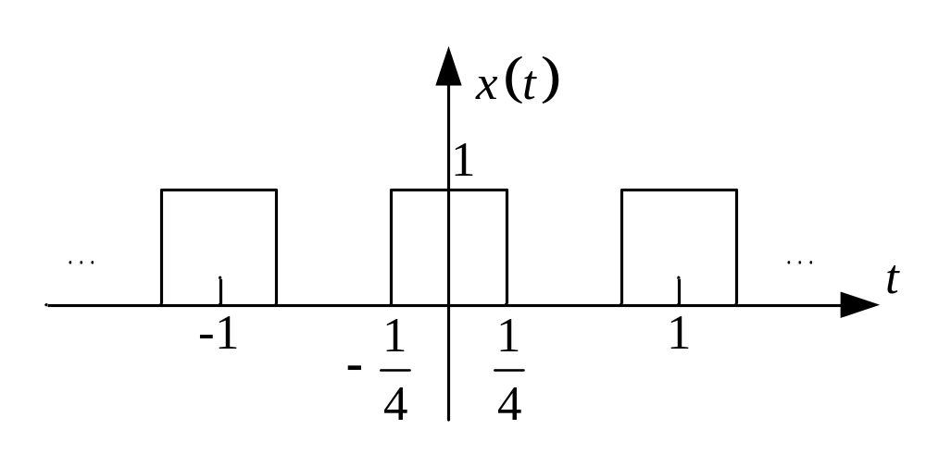
Suppose an LTI system with unit impulse response
, The input signal x(t) is a periodic signal depicted in the following figure, find the system output y(t)

Slide 17
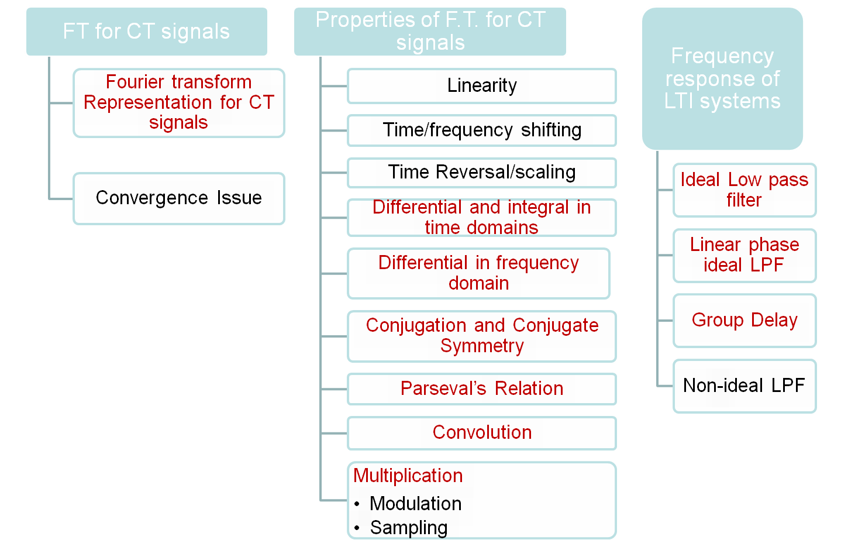
Ch. 4

Slide 18
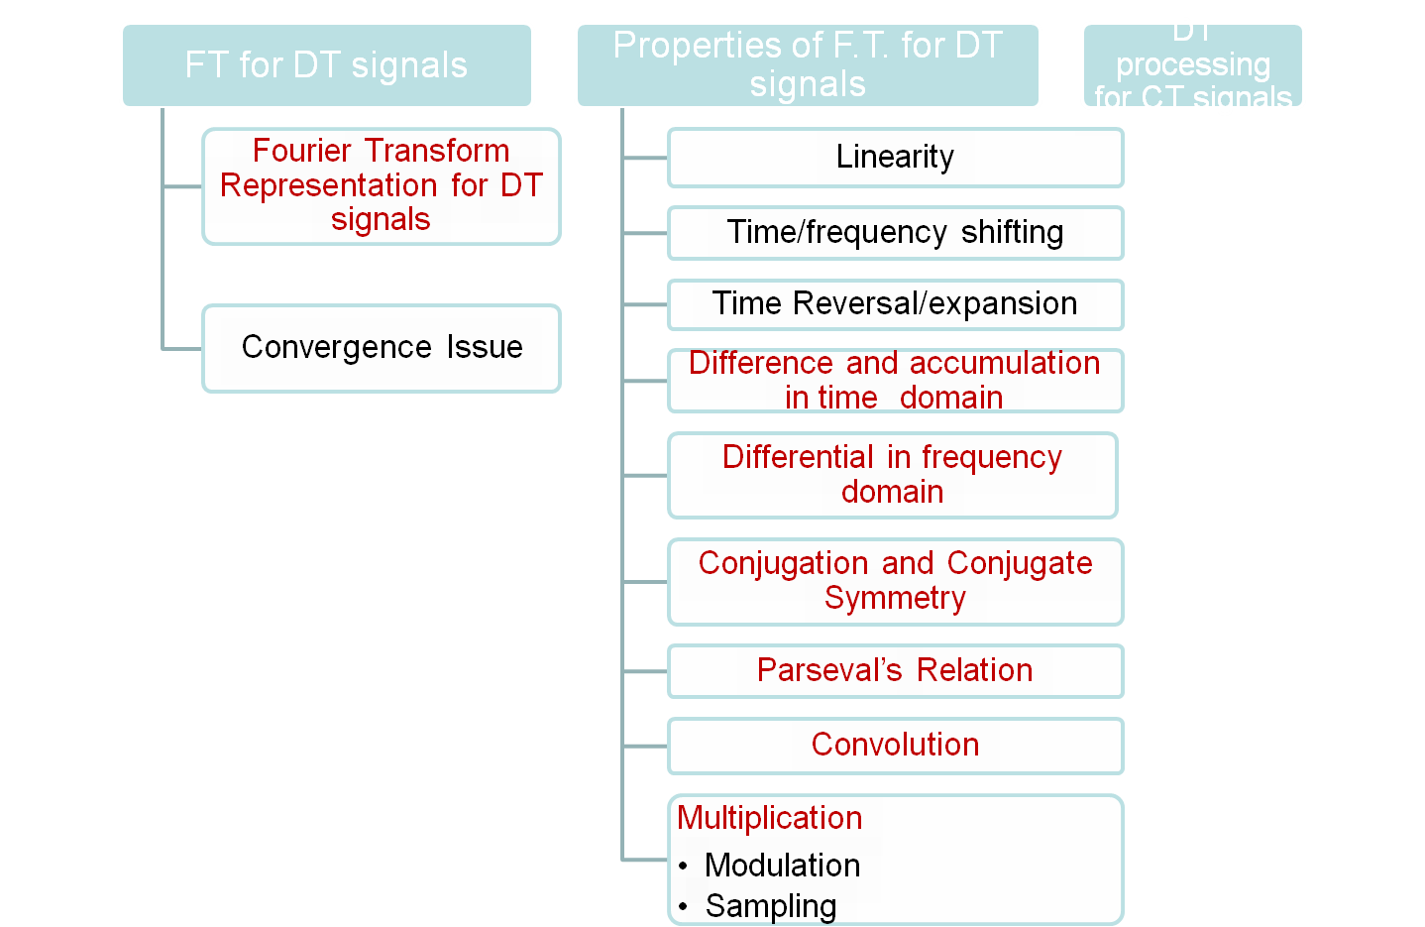
Ch. 5

Slide 19
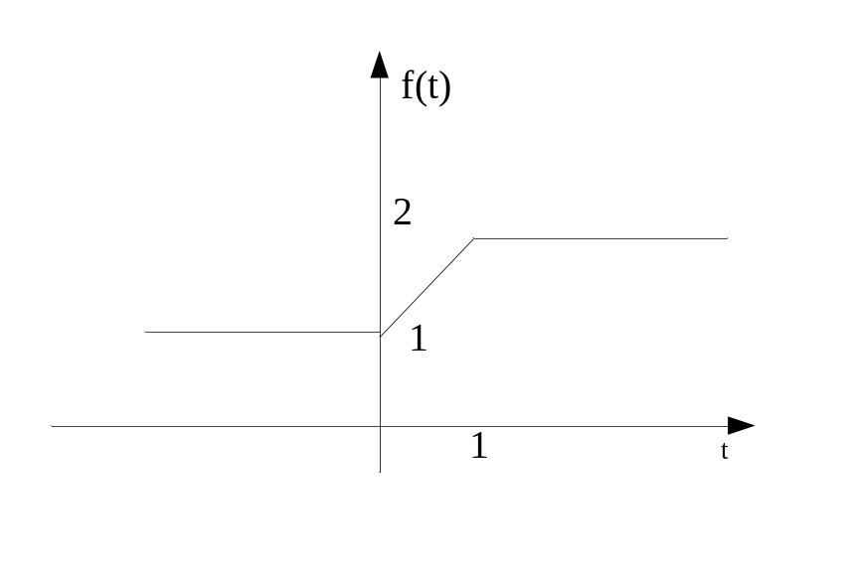
To calculate the Fourier transform of the signal shown in the figure
key point: some conditions to apply the properties of the Fourier transform
Since f(t) is not absolutely integrable, we cannot using the analysis equation to calculate its Fourier transform directly.
We’d resort approaches to exploit the F.T. properties on some typical signals.

Slide 20
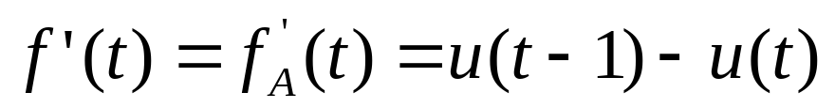
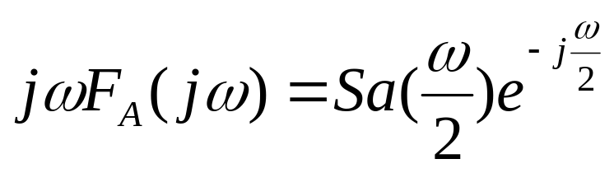
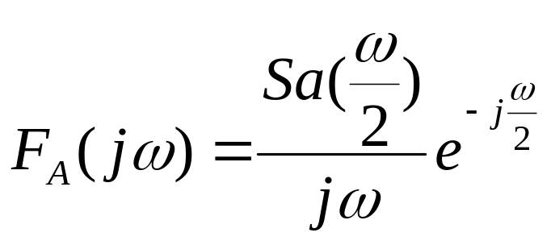
Sol. 1 Differential property
f(t)=f_{DC}(t)+f_{A}(t)=3/2+f_{A}(t)
So F(jω)=F_{DC}(jω)+F_{A}(jω)=3πδ(ω)+F_{A}(jω)
Then

Slide 21
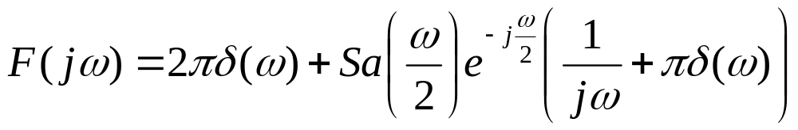
Sol. 2: Integration property
f(t)=1+(u(t)-u(t-1))*u(t)

Slide 22
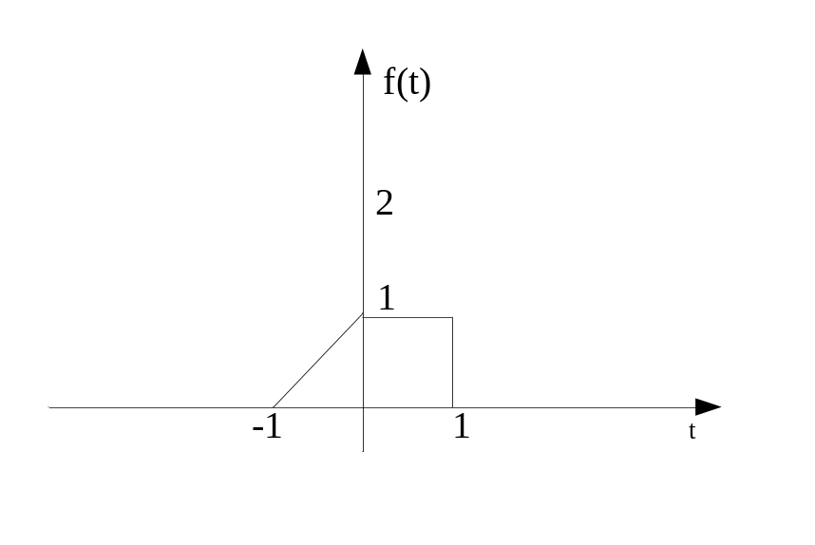
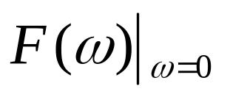
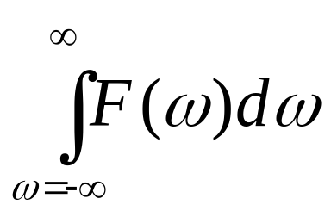
Consider a CT signal f(t) with its Fourier transform of F(jω),
to calculate the following expressions.
1) =1.5
2) =2π

Slide 23
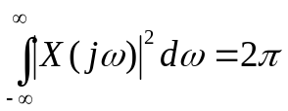
Consider a signal x(t) with Fourier transform X(jω) satisfying the following facts:
  x(t) is real and non-negative
  The inverse Fourier transform of (1+jω)X(jω) is Ae^{-2t}u(t), where A is independent of t
Determine a closed-form expression of x(t) (P4.14)

Slide 24
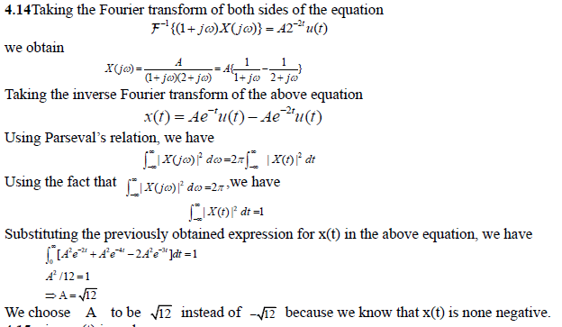

Slide 25
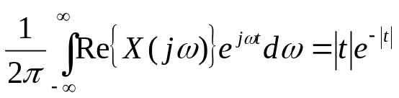
Consider a signal x(t) with Fourier transform X(jω) satisfying the following facts:
  x(t) is real
  x(t)=0 for x≤0
Determine a closed-form expression of x(t) (P4.15)
Important: For a CT system with a real, causal impulse response h(t) is that H(jω) is completely specified by its real part -----real-part sufficient property

Slide 26
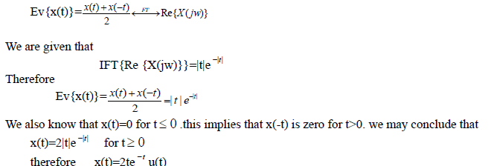

Slide 27

Consider a CT signal x(t) has its Fourier transform in the form of
Determine the inverse Fourier transform of X(jω)
Hints: exploit the scaling and duality properties of the Fourier transform

Slide 28
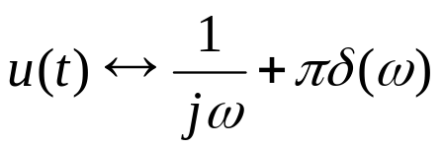
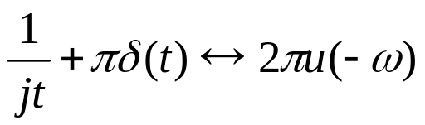
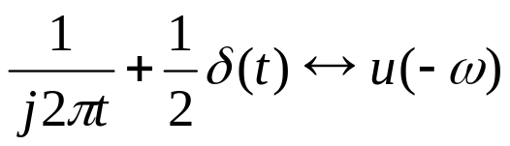
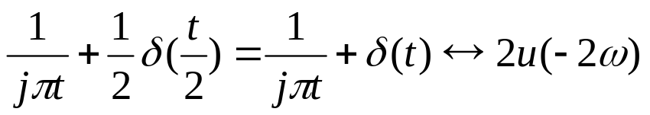
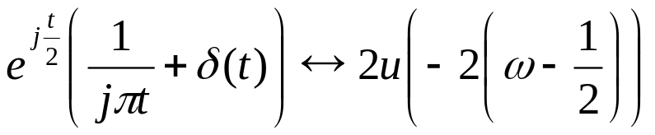
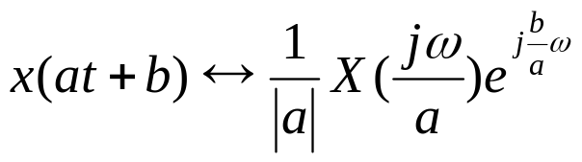
Similar to

Slide 29
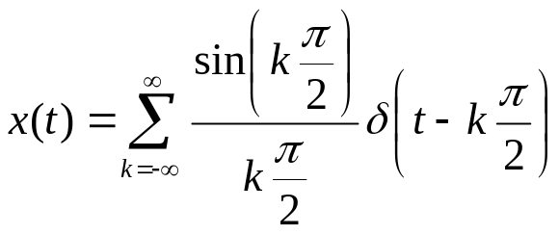
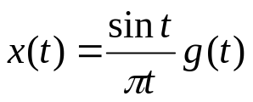
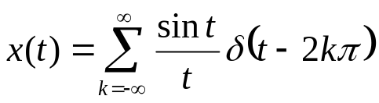
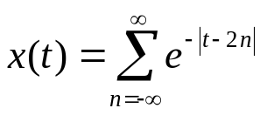
Consider the signal
Determine g(t) such that
Compute the Fourier transform of x(t)
If , re-compute 2) ---(P4.16)
If , to calculate its Fourier transform. ---(P4.21(j))

Slide 30
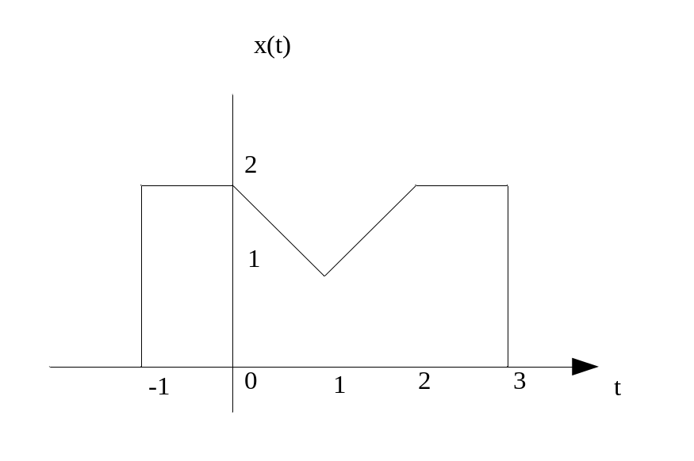



Let X(jω) denote the Fourier transform of the signal x(t), which is depicted in the following Figure.
Find its phase-spectrum property ≮X(jω)
Find X(j0)
Find
Evaluate
Evaluate

Slide 31
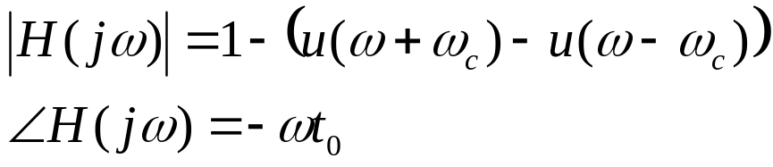
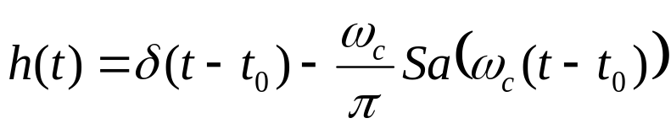
Consider a linear phase high pass filter with the following magnitude and phase –spectrum response,
calculate its unit impulse response

Slide 32
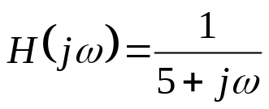
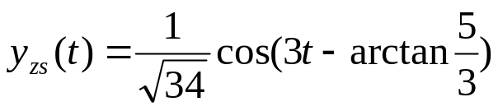
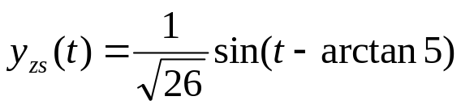
For a system with system function of H(jω), to determine the zero-state response of the system to the input
Cos3t
sint

Slide 33
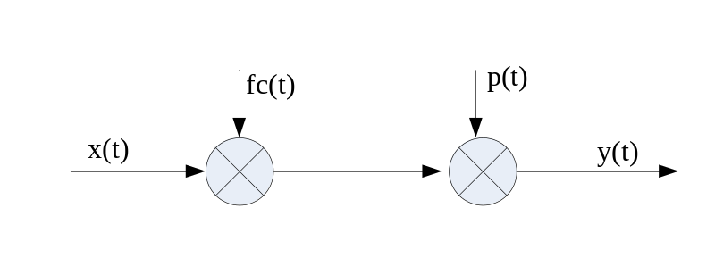

For a system depicted in the following Figure, fc(t)=Sa(2000πt), x(t)=Sa(1000πt),
the sampling function is
To determine the maximal sampling period Tmax, which could recover the product of fc(t) and x(t) undistorted.
When T=Tmax, plot the magnitude spectrum of y(t), i.e. |Y(jω)|

Slide 34

Ch. 6

Slide 35

Ch. 7

Slide 36


For an input x(t), if the Laplace transform of a system output y(t) is Y(s), and
with its RoC satisfying
To determine its steady response
Hints
Using final-value theorem of the Laplace transform?
By means of the PFE approach to calculate its inverse Laplace transform?
Different results! Why
y(∞) is not a deterministic value, which is the condition that the final-value theorem could apply. i.e. only when sF(s) is converged at the right-half plane including s=jw axis

Slide 37



Consider a causal LTI system represented by an LCCDE
where a is real
Find the transform function of the system (system function, frequency response of the system ….)
Determine its zeros, poles, and RoC in the complex s-plane
When a=0.5, to plot the magnitude of the frequency response of the system, and determine whether it is approximately lowpass, highpass or bandpass filter.
If the LCCDE is in the form of or
, repeat 1)~3)
Similar to P9.16

Slide 38
Example 9.26, 9.27

Slide 39
For a given block diagram of a system, please find
its linear difference equation
its system function H(z)
Its zeros and poles, and RoC, and sketch its pole-zero plot and RoC in z plane.
its impulse response
its frequency response, and sketch its magnitude spectrum and phase spectrum

Slide 40





For and x[n]=nx₁[n]
to calculate the unilateral Z transform of x(n), X(z)

Slide 41






For a DT system, when the input x[n]=u[n], the zero-state response of the system y_{zs}[n]=3^{n}u[n], to find the zero-state response of the system when the input x[n]=(n+1)u[n]

Slide 42


For a causal DT system depicted in the figure, to find the design rule for the parameter a to make the system stable
Discussions: considering the fact that the system is causal, the RoC should be the |z|>|z₀|, so to make the system stable, the pole should be located within the unit circle, i.e.
|1+a|<1

